Slide 1

Scale your data driven decision making

Slide 2
The Problem
Different teams around the organisation use different tools & workflows to analyse data & generate insights.
But there is no one place to share all output formats, so knowledge becomes scattered.

Slide 3
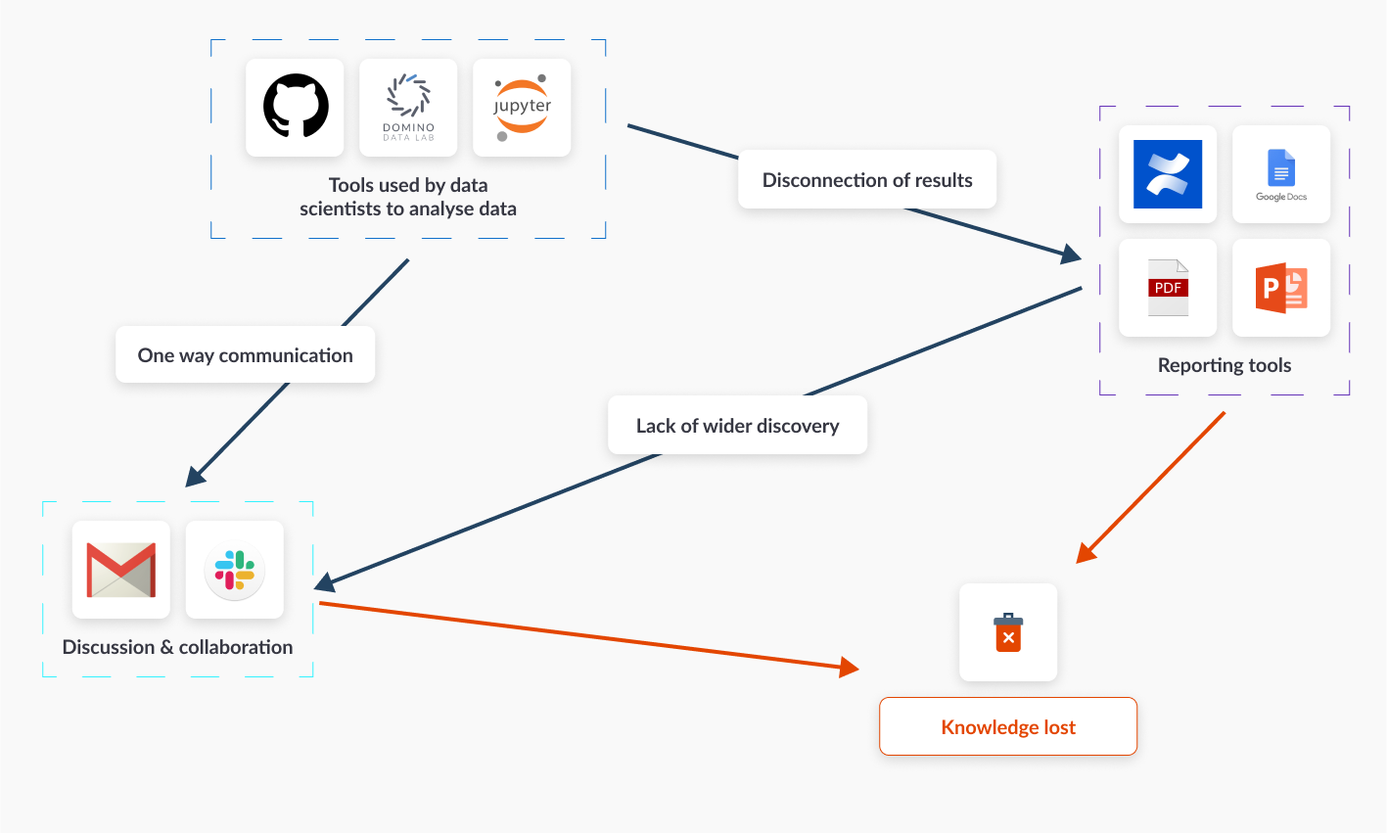

Slide 4
Why is this happening?
Can’t share reports: The tools used for technical analyses are not accessible to everyone, meaning results are difficult to consistently share with a wider audience.
Can’t track projects: These results need to be converted to other formats just to be shared, leading to a disconnection between the data & presentation tooling.
Can’t discover knowledge when it’s needed: Users spend too much time searching for information, instead of having on-demand access to research potentially relevant to their own work.

Slide 5
The Result?
Teams operate in their own silos, such that interesting & important insights often go undiscovered.

Slide 6
Lower returns on your data science efforts
Data users waste too much time compiling PDFs and presentations from their analyses, only to share one-to-one in meetings, via email or chat.
Insights that SHOULD have repeat-use value become lost to the email archive or to the Slack history channel.
Employees and departments that could have benefited from certain data insights never actually discover them.
This means that the same work is repeated over & over again across different teams.

Slide 7
The Solution
Kyso - the universal aggregator for all research workflows & formats.

Slide 8
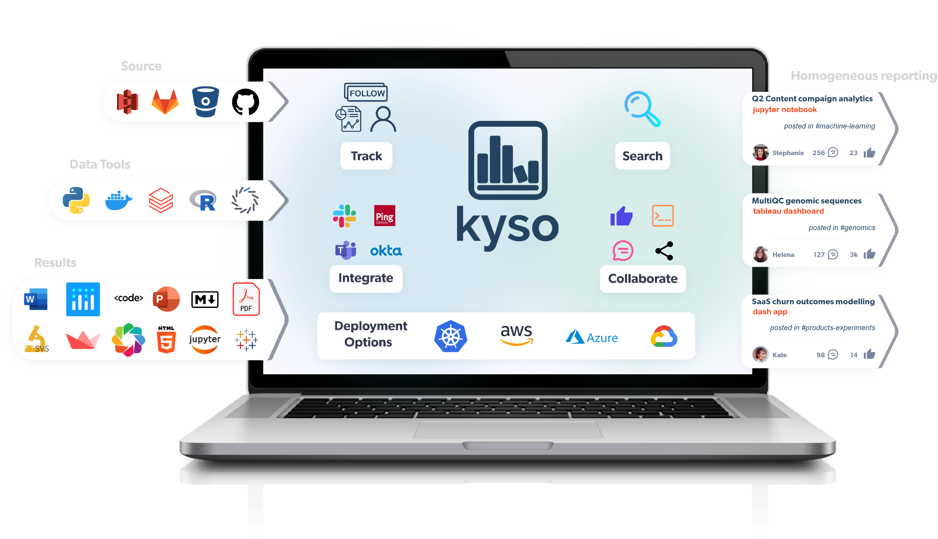

Slide 9
The Result?
Your organisation can now truly begin to leverage value created. Everybody can make the best decisions because they have access to up-to-date information, on demand.

Slide 10
Actionable knowledge is consolidated
Kyso becomes the single reference point for insights & discussion from data throughout the whole organisation.
Everyone in the company can now discover reports naturally and use them to take action in their own space.
Published results are connected to the source analyses through integration with the data tools, thus maintaining version control and reproducibility.
Teams can now compound on existing knowledge, discuss results across teams, ask questions and provide feedback, and make more data-informed decisions.

Slide 11
How does it work?
Bridging the communication gap and turning siloed data insights and discussion into action.
A simple workflow example...

Slide 12


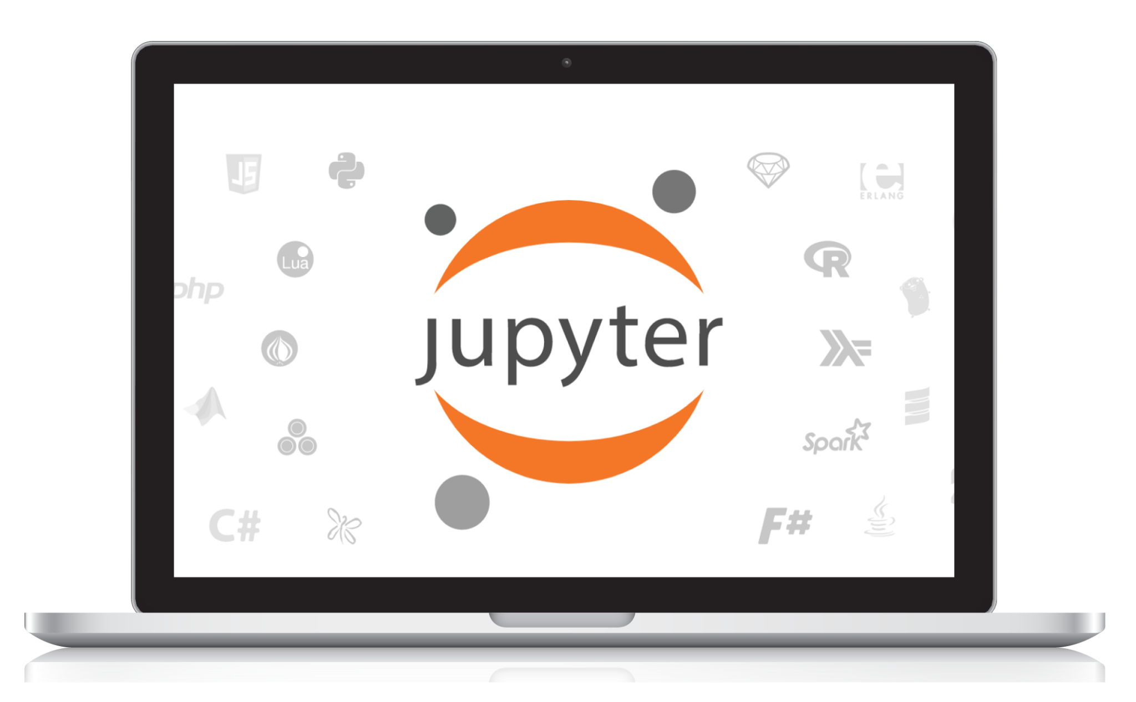
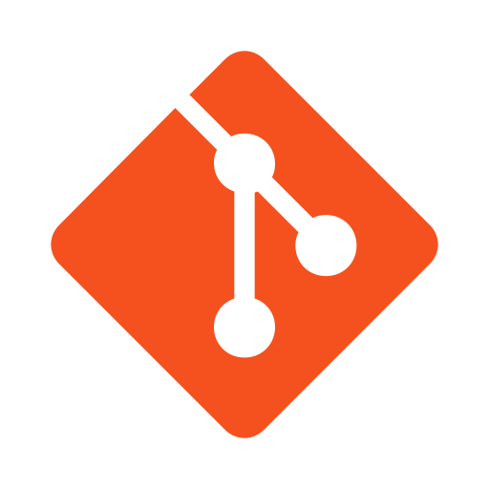
A data scientist is working on a new, interesting analysis with their team…
...and push their work to Git, where their changes will be automatically sent upstream to Kyso upon review by the team lead…

Slide 13
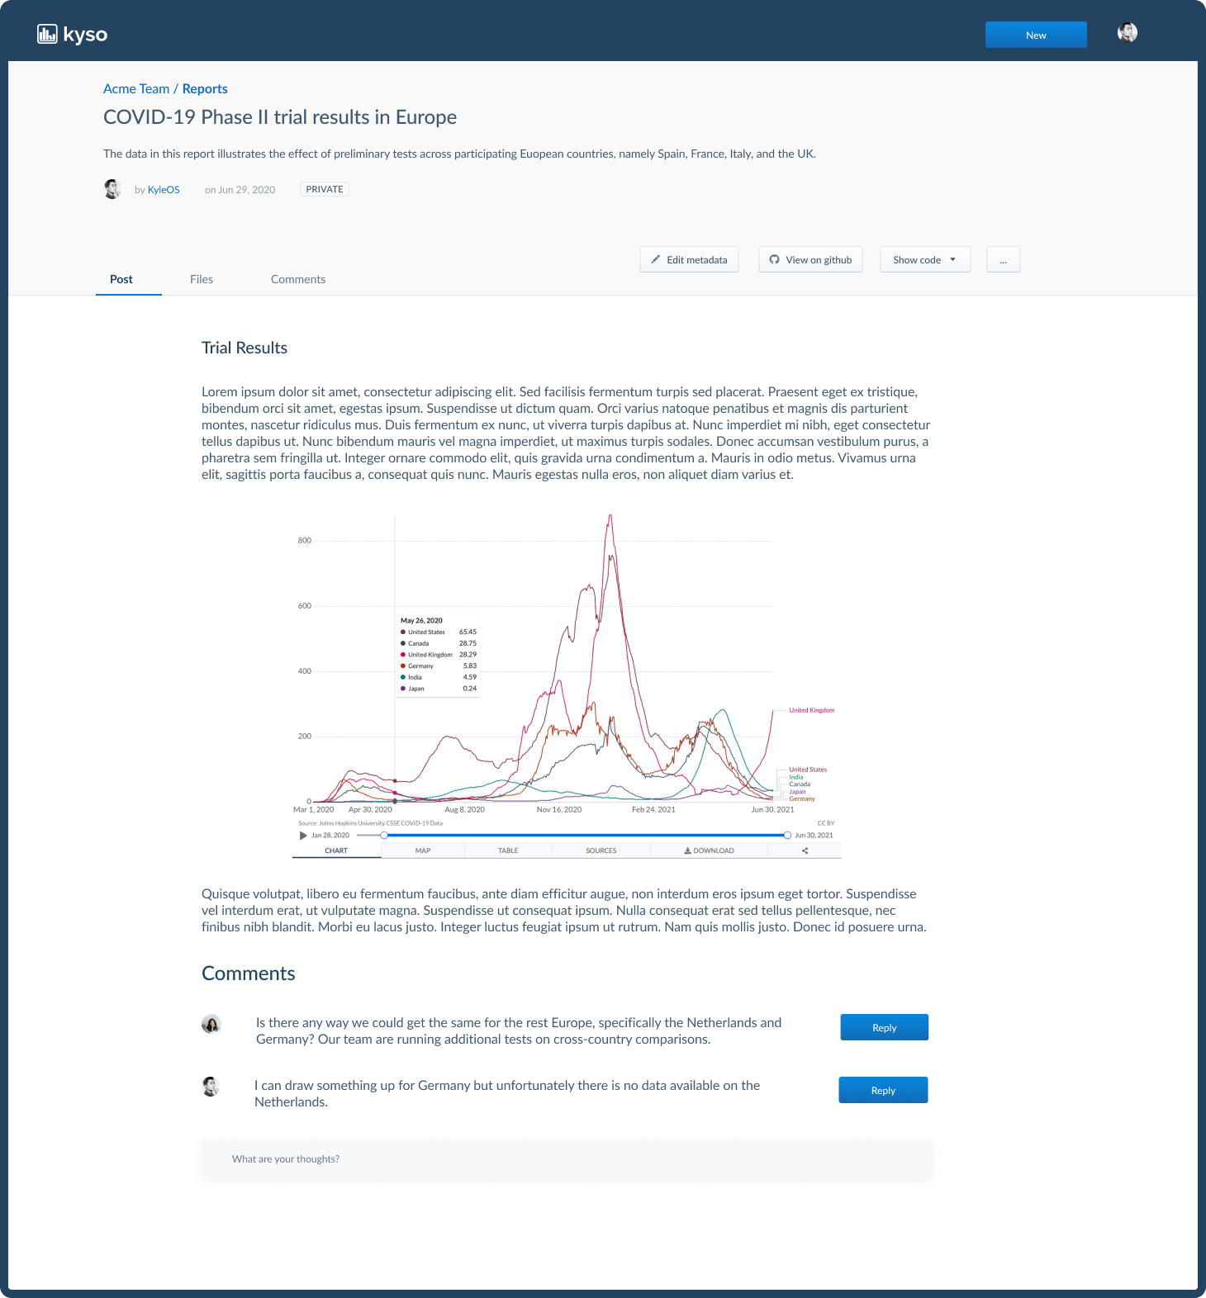
Anyone subscribed to the channel can learn, comment and discuss results.
The report is rendered with full interactivity & now any future changes to the analysis will be tracked & automatically reflected on Kyso.

Slide 14
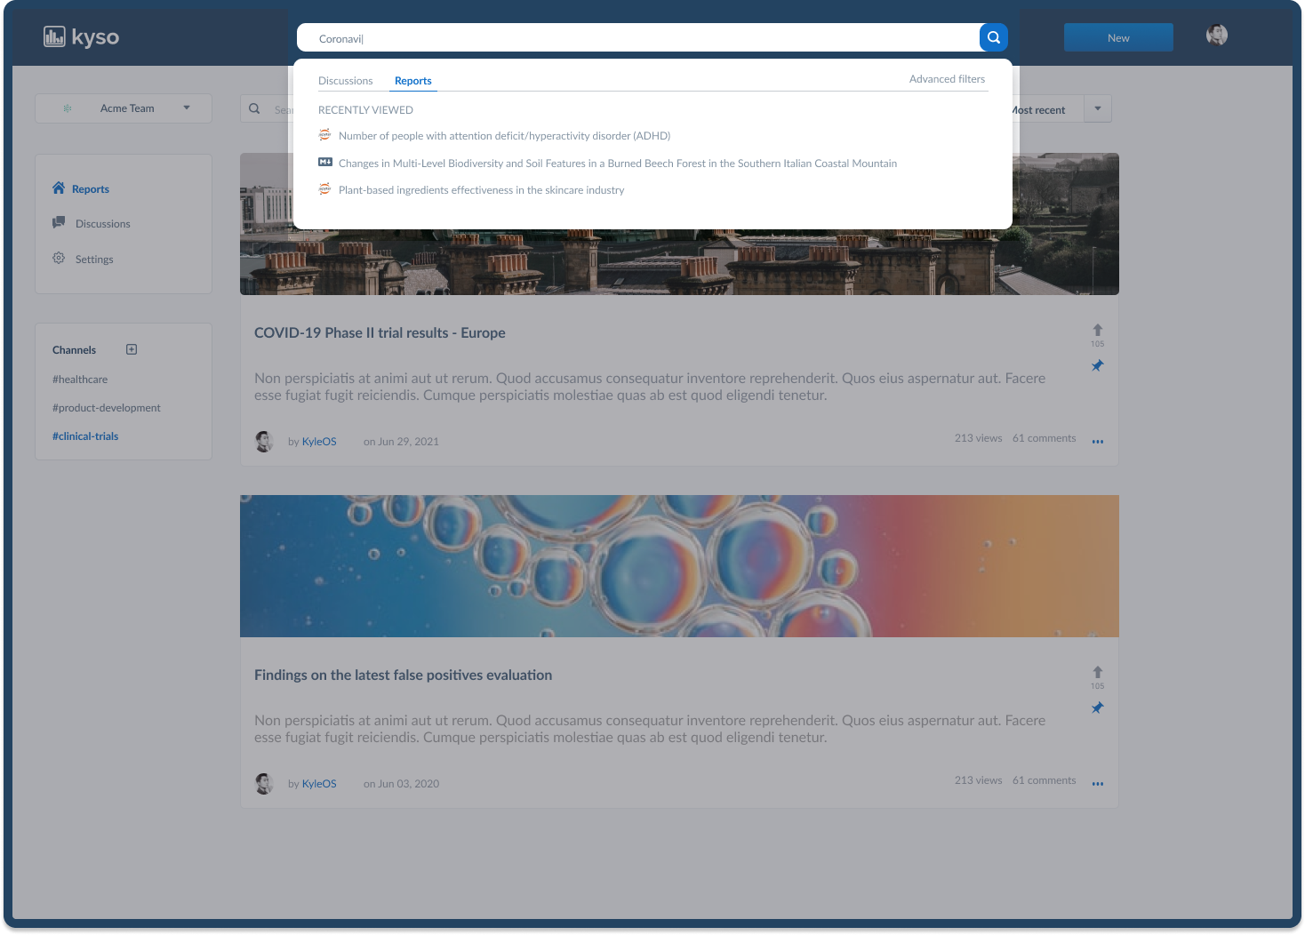
Now anyone else looking for similar research in the future can find the report on-demand.

Slide 15
What you get
Kyso’s application functionalities and enterprise tier features...

Slide 16
Application highlights
Beautiful Presentation Auto-rendering of the technical documents used by analysts as presentable data-based reports.
Discussion & Feedback Comment and collaborate directly on individual reports or initiate project-wide & general discussions.
Full Access Control
Select which functionalities are available to different team members, technical or non-technical. Create user groups and control access to analytics.
Indexing & Organization Gamification in views, upvotes, etc. acts as an auto-indexer & keeps team members engaged. Channels and tagging keep your content organized.
Comprehensive Search & Discovery
Research & analyses are discoverable on multiple different levels, including channels & tags, report metadata, and full-text search.
Measure Impact & Success
Activity metrics provide clarity on what people need around the business, what they are searching for, which projects are making an impact, allowing teams to produce more effective, relevant content.

Slide 17
Your Enterprise package also includes..
Single Sign-on Secure access with existing Google or SAML credentials. Scale to everyone around the business quickly and effectively.
Any Deployment Method Our team is very flexible on our self-hosted builds. Simply choose your preferred deployment method and we will work with you to make that happen!
Custom Features on Request
We like to work closely with our clients on their specific use-cases and our product roadmap. Need something extra? Just ask!
Premium Support Your own support account manager with priority web and phone support.
Security
With no public internet access required, Kyso can function within your company’s firewalls, meaning you have COMPLETE control of your data.
All New Premium Features
Our team continues to work hard on building out the app. All new & exciting premium features that you want can be added to your deployment as they become available.

